Slide 1
Communication Technologies for the Smart Grid

Slide 2
The communication infrastructure of a power system typically consists of SCADA systems with dedicated communication channels to and from the System Control Centre and a Wide Area Network (WAN).
Some long-established power utilities may have private telephone networks and other legacy communication systems.
The SCADA systems connect all the major power system operational facilities, that is, the central generating stations, the transmission grid substations and the primary distribution substations to the System Control Centre

Slide 3
An essential development of the Smart Grid (Figure 3.1) is to extend communication throughout the distribution system and to establish two-way communications with customers through Neighbourhood Area Networks (NANs) covering the areas served by distribution substations.
Customers’ premises will have Home Area Networks (HANs). The interface of the Home and Neighbourhood Area Networks will be through a smart meter or smart interfacing device.

Slide 4
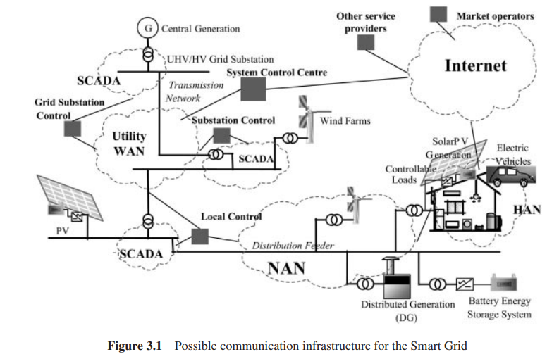

Slide 5
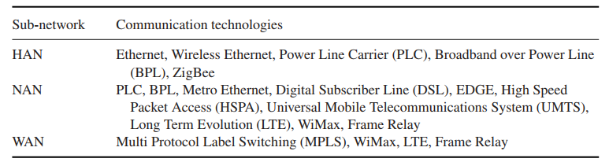

Slide 6
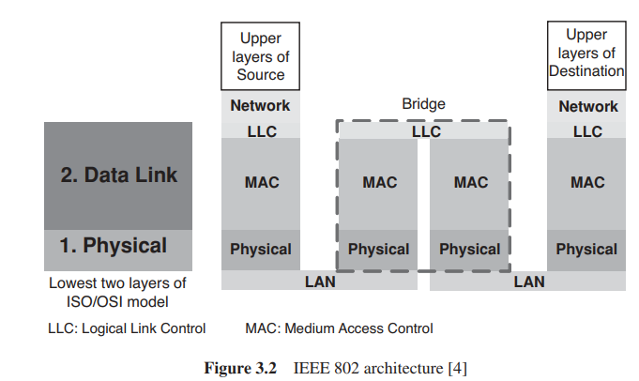

Slide 7
Figure 3.2 shows how the IEEE 802 architecture relates to the lowest two layers of the ISO/OSI reference model [3, 4]. It shows how two LANs may be connected through a Bridge
Such a connection is common in many organisations which have multiple LANs. A packet from the Source enters the Logical Link Control (LLC) sublayer which acts as an interface between the network layer and the MAC sublayer.

Slide 8
The LLC sublayer is defined by IEEE 802.2 and provides multiplexing mechanisms, flow control and error control. The packet then passes into the MAC sublayer. At the MAC sublayer, a header and a trailer (depending on the LAN which the packet is entering) are added to the packet.
Then it goes through the physical layer and the communication channel and reaches the Bridge

Slide 9
Ethernet
Ethernet has become the most widely used network technology for wired LANs due to its simplicity, ease of maintenance, ability to incorporate new technologies and reliability. It has a low cost of installation and is easy to upgrade

Slide 10
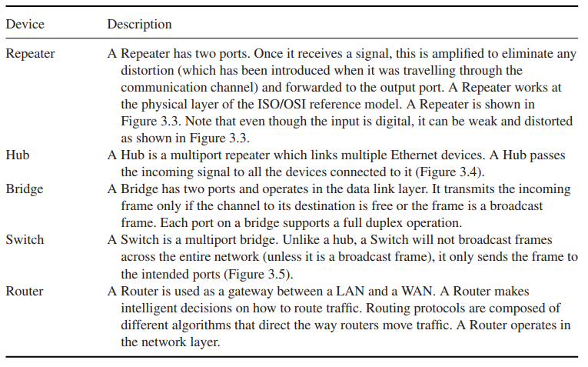

Slide 11
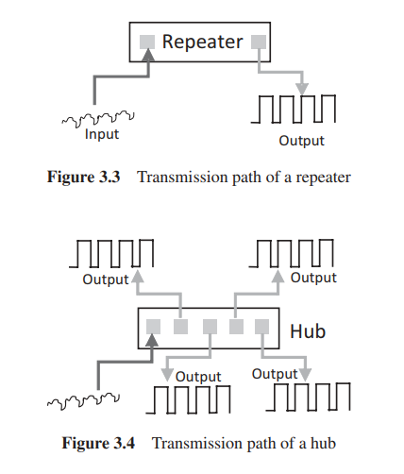

Slide 12
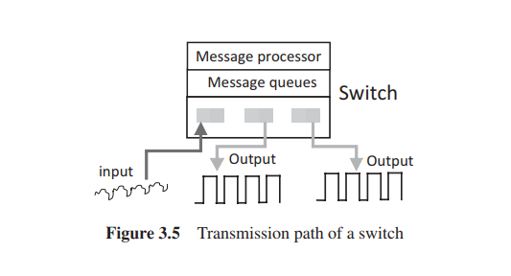

Slide 13
Wireless LANs
IEEE 802.11 describes the Wireless LAN (WLAN) standard. The interoperability of IEEE 802.11 devices is certified by the Wi-Fi Alliance.1 Wireless LANs consist of the following components:
Station
Access points (AP)
Distribution system (DS)

Slide 14
Station:
This describes any device that communicates over a WLAN, for example, a notebook computer, or mobile phones that support WiFi.
Such a collection of stations forming an ad-hoc network is called an Independent Basic Service Set (Independent BSS or IBSS).

Slide 15
Access points (AP):
When an AP is present in a network, it allows one station to communicate with another through it.
However, there are benefits of having an AP in a network. APs make the system scalable and allow wired connection to other networks. Also APs buffer the traffic when that station is operating in a very low power state.

Slide 16
Distribution system (DS):
A Distribution System interconnects multiple Infrastructure BSSs through their APs as shown in Figure 3.9. It facilitates communication between APs, forwarding traffic from one BSS to another and the movement of mobile stations among BSSs. Such a set of Infrastructure BSSs is called an Extended Service Set (ESS).

Slide 17
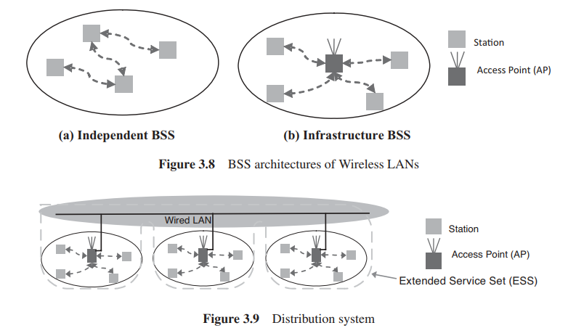

Slide 18
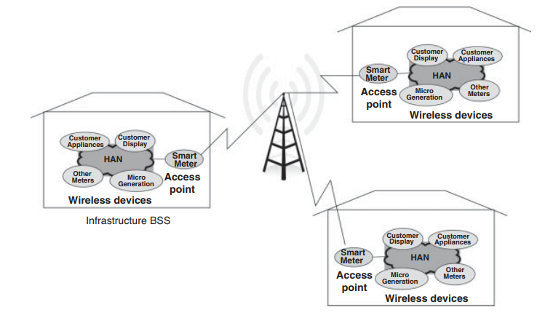
Bluetooth
Bluetooth, defined by IEEE standard 802.15.1, is a wireless LAN technology designed to connect mobile or fixed devices using low-power, short-distance radio transmission.

Slide 19
ZigBee and 6LoWPAN
ZigBee and 6LoWPAN are two communication technologies built on IEEE 802.15.4. This is a low data rate wireless networking standard. Currently this standard is the most popular protocol for a Wireless Public Area Networks (WPAN) due to its low power consumption,

Slide 20
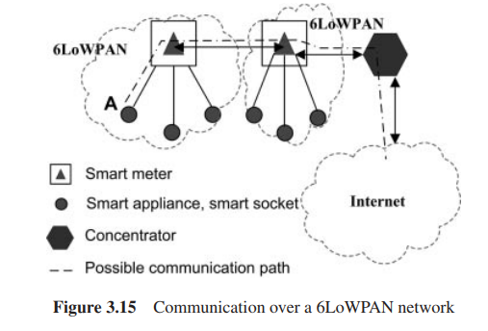

Slide 21
WiMAX
Worldwide Interoperability for Microwave Access (WiMAX) is a wireless technology which conforms with the IEEE 802.16 standard. It provides both fixed and mobile connectivity using a technique called Orthogonal Frequency Division Multiple Access (OFDMA).
The coverage of WiMAX extends up to 50 km with peak data rates of 75 Mbps for fixed connections and up to 15 Mbps for mobile connections. These data rates are expected to increase beyond 200 Mbps in Uplink and 300 Mbps in Downlink with the release of IEEE 802.16m-2011

Slide 22
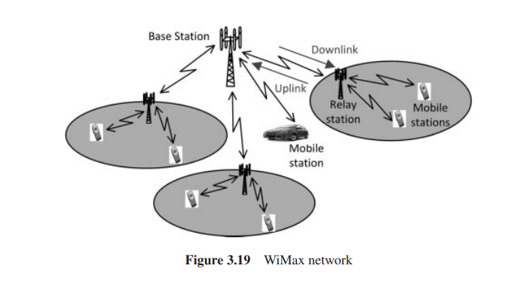

Slide 23
DNP3
DNP3 (Distributed Network Protocol) is a set of communication protocols developed for communications between various types of data acquisition and control equipment.
It plays a crucial role in SCADA systems, where it is used by Control Centres, RTUs and IEDs. DNP3 has recently been adopted as an IEEE standard 1815–2010 [8].

Slide 24
DNP3 has five layers as shown in Figure 3.26. The DNP User layer can take analogue and binary inputs and output analogue and binary signals.
A Master DNP3 station sends requests and typically the Slave DNP3 stations respond to these requests. However, a Slave DNP3 station may also transmit a message without a request.
The DNP3 Physical layer most commonly uses serial communication protocols such as EIA 232 or EIA 485. Recently applications of DNP3 over an Ethernet connection can be found.

Slide 25
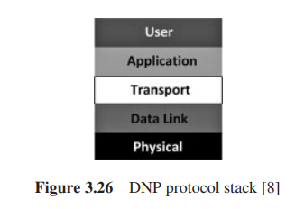

Slide 26
IEC 61850
IEC 61850 is an open standard for Ethernet communication within substations. It is a function based standard which ensures interoperability of substation equipment. The functions are divided into:
system support functions: network management, time synchronization and physical device self-checking;
system configuration or maintenance functions: software management, configuration management, settings and test modes;
operational or control functions: parameter set switching, alarm management and fault record retrievals;
process automation functions: protection, interlocking and load shedding.

Slide 27
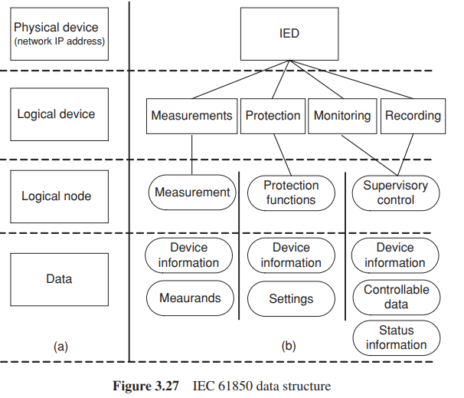

Slide 28
Wide Area Monitoring Systems (WAMS)
Utilities have designed and employed WAMS, to optimize transmission grid capacity and to avoid the spread of disturbances.
• By providing real - time information on stability and operating safety margins, WAMS give early warnings of system disturbances for the prevention and mitigation of system - wide blackouts.
• WAMS utilize sensors, distributed throughout the network in combination with GPS satellites, for precise time stamping of measurements in the transmission system.
• The integrated sensors will interface with the communication network.
• Phasor measurement units (PMU) are a current technology that is a component of most smart grid designs.

Slide 29
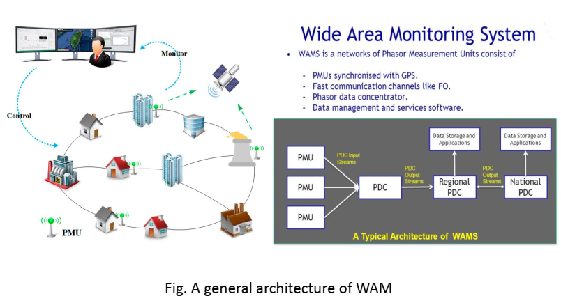

Slide 30
Phasor Measurement Units (PMU)/ (MPSM)
MUs consist of bus voltage phasors, branch current phasors, and information such as locations, other network parameters.
• Precise phasor measurements allows an operator to visualize exact angular difference between different locations, situational awareness & ease congestion.
• PMUs are equipped with GPS receivers, allow synchronization of readings, taken at distant points.
• Instrumentation (u-processor) i.e. protection relays and disturbance fault recorders (DFRs); are incorporated within PMU module

Slide 31
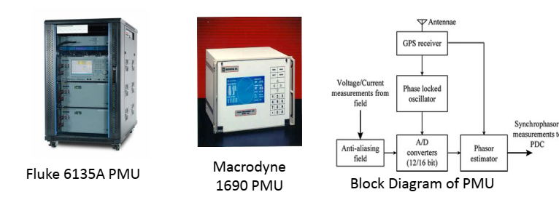

Slide 32
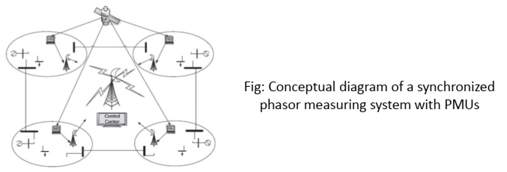

Slide 33
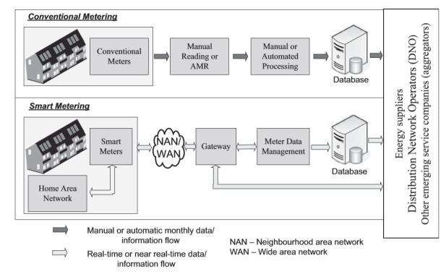

Slide 34
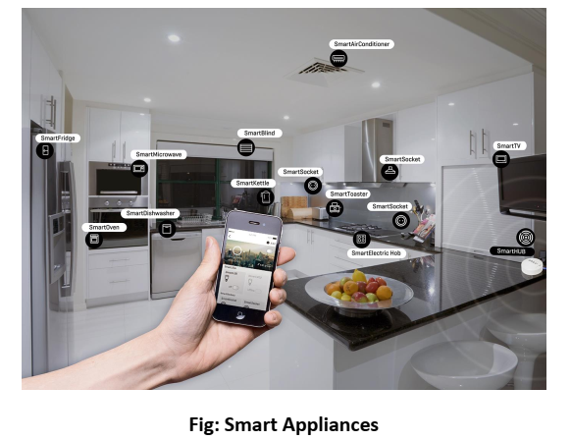

Slide 35
